Slide 1

Machine Learning
Exam 1 Review
Notes:
Guidelines
Use section headers to chunk content in your presentation.
Use the same style of section header throughout your presentation.
Keep your title to no more than 2 lines.

Slide 2
Exam 1 Review
Notes:
Guidelines
Use a title slide at the beginning of your presentation. There are 9 variations of title slides to choose from.
If you will have a series of slideshows, we recommend using the same style of title slide for each presentation.
Keep your title to no more than 2 lines.
Do not change the font style or font size of the title or subtitle.

Slide 3
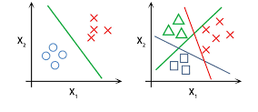
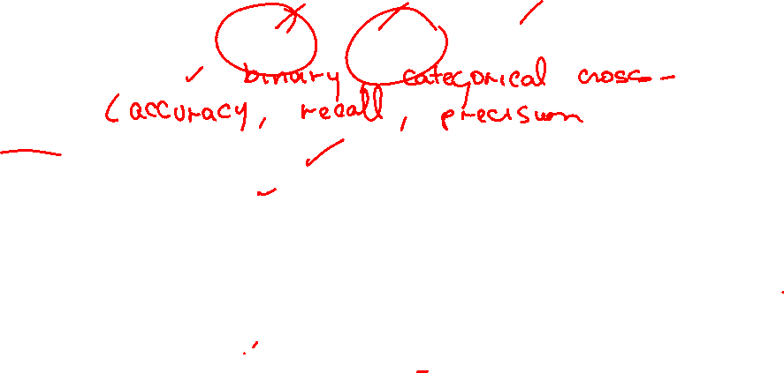
Classification
Type of problem (binary, multi-class, multi-label)
Cost function
Metrics
Regularization
NN Output Activations
Gradient Descent
Learning rate
Convergence vs Divergence

Slide 4



Please download and install the Slido app on all computers you use
What type of problem is this?
ⓘ Start presenting to display the poll results on this slide.

Slide 5
Please download and install the Slido app on all computers you use
What cost function do we need?
ⓘ Start presenting to display the poll results on this slide.

Slide 6
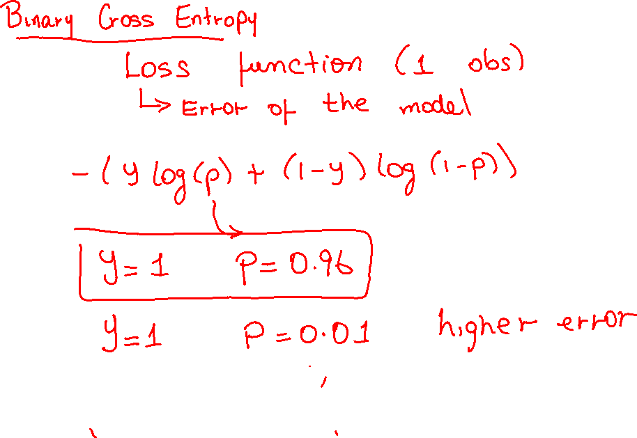

Slide 7
Please download and install the Slido app on all computers you use
Which metric can you report?
ⓘ Start presenting to display the poll results on this slide.

Slide 8
Please download and install the Slido app on all computers you use
A churn prediction model outputs a probability of 0.85 that a customer will churn. The actual label is 1 (the customer churned). What is the binary cross-entropy loss for this single prediction?
ⓘ Start presenting to display the poll results on this slide.

Slide 9
Please download and install the Slido app on all computers you use
You are given a model that predicts the probability of customer churn for four customers. The actual churn labels (1 = churn, 0 = no churn) and the model’s predicted probabilities are shown in the table below:
ⓘ Start presenting to display the poll results on this slide.

Slide 10
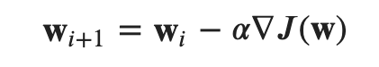
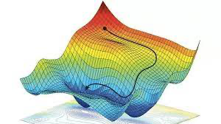
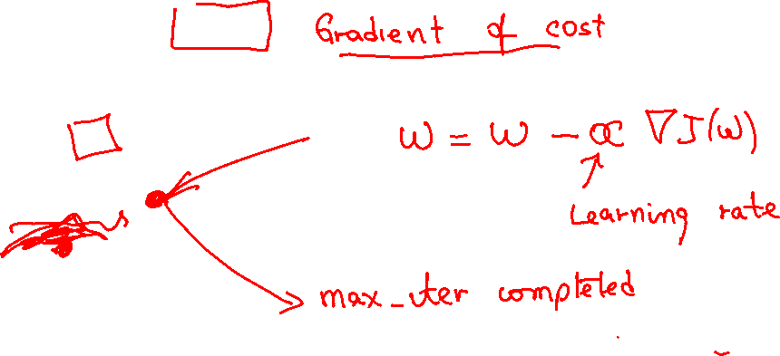

Gradient Descent Algorithm
Based on going in the direction of the decreasing gradient
$$J\left(w\right)$$

Slide 11
Please download and install the Slido app on all computers you use
What is the most likely case given the learning curve given below
ⓘ Start presenting to display the poll results on this slide.

Slide 12
Please download and install the Slido app on all computers you use
What is the most likely case given the learning curve below
ⓘ Start presenting to display the poll results on this slide.

Slide 13
Please download and install the Slido app on all computers you use
What is the most likely case given the learning curve below
ⓘ Start presenting to display the poll results on this slide.

Slide 14
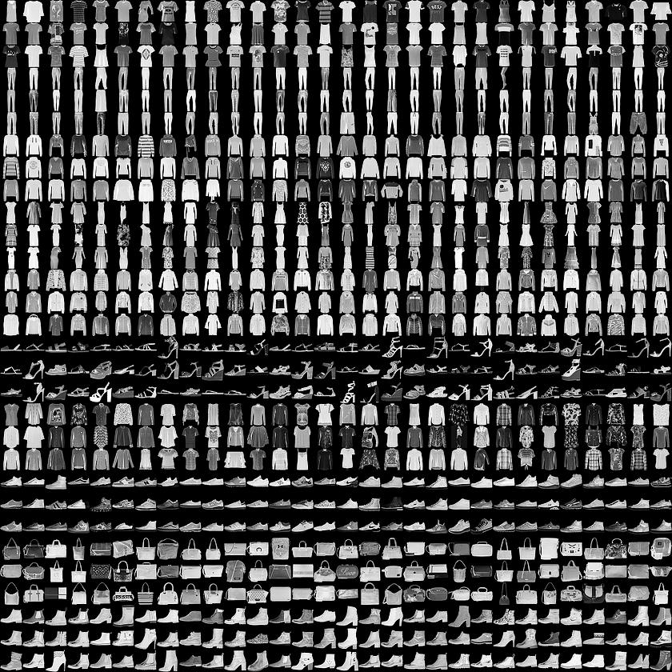
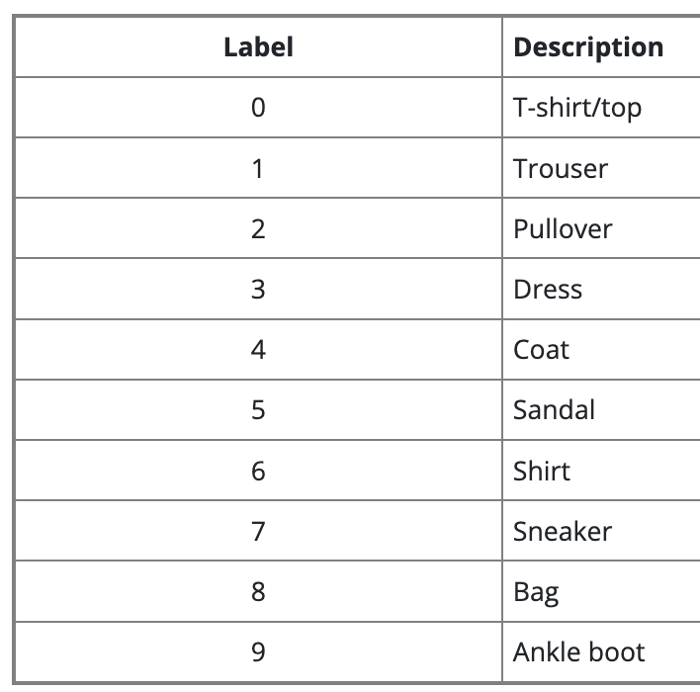
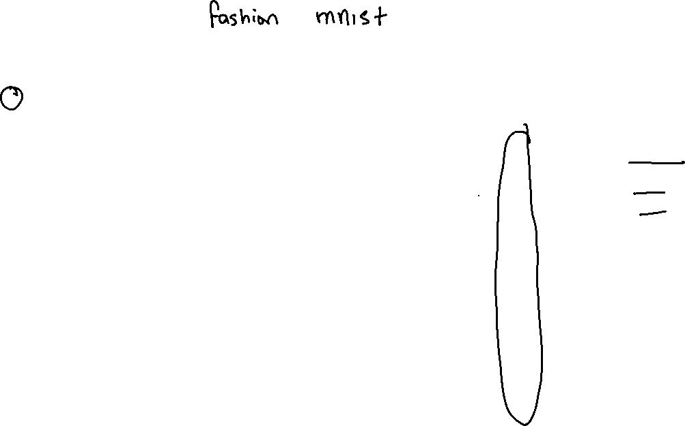
Image Classification Example

Slide 15
Please download and install the Slido app on all computers you use
What type of problem is this?
ⓘ Start presenting to display the poll results on this slide.

Slide 16
Please download and install the Slido app on all computers you use
What cost function(s) can we use?
ⓘ Start presenting to display the poll results on this slide.

Slide 17
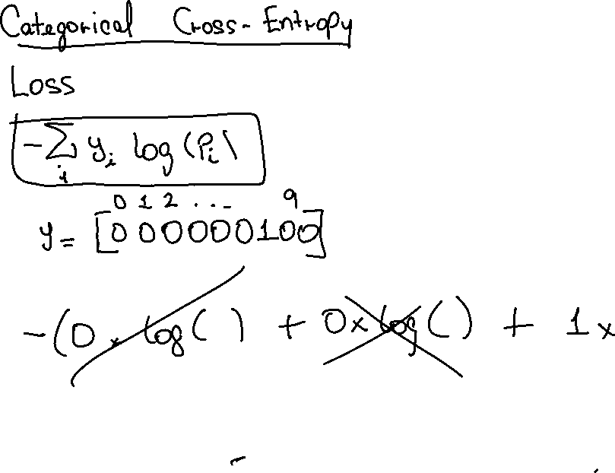

Slide 18
Please download and install the Slido app on all computers you use
A Fashion MNIST model makes the following probability predictions for an image. The true class is “Sneaker” (Class 7).
ⓘ Start presenting to display the poll results on this slide.

Slide 19
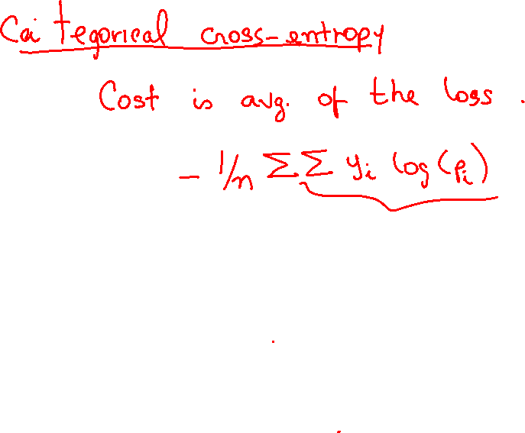

Slide 20
Please download and install the Slido app on all computers you use
A Fashion MNIST model makes the following probability predictions for 4 images, with the actual class labels provided.
ⓘ Start presenting to display the poll results on this slide.

